Slide 1
Jon Rosner Symposium “Jon the Educator ” Richard Robinett* Department of Physics Penn State University
Friday, April 1, 2011
From the conference web site:
“In both areas, Jon is a distinguished
and award-winning teacher.”
* Graduated from Minnesota (not Chicago) 1975, 1981

Slide 2
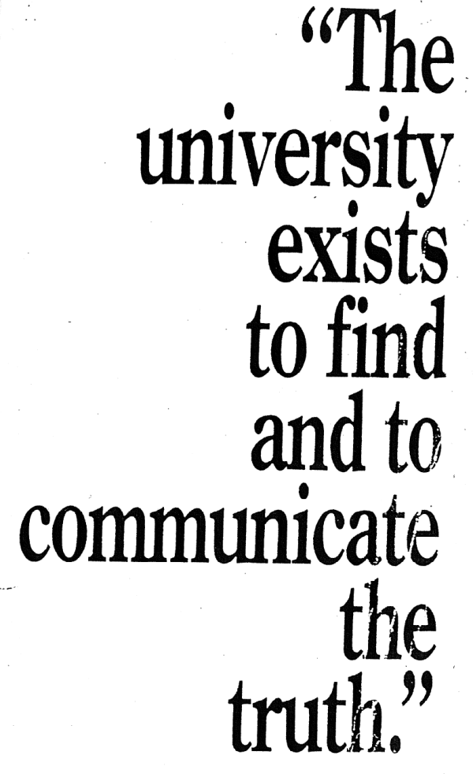
Why the focus on education?
The following quote has been staring at me every day for 25 years since I became a professor – because I stuck it on my blackboard.
“The University exists (only) to find and communicate the truth.”
I wanted to focus on, and honor, the ‘communicate’ part
“Education is what remains after one has forgotten everything one learned in school”
A. Einstein (so says the web)
This suggests ALL aspects of an educational experience
Classroom instruction
Pedagogical innovations
Research mentoring
Career preparation
Attitude, life skills, etc.

Slide 3
Musings on famous sayings
“The University exists (only) to find and communicate the truth.”
Who said that?
Robert Maynard Hutchins (1899 – 1977)
President University of Chicago (1929-1951)
What else is Hutchins known for?
Great Books and Socratic dialog curriculum
Abandoned after he left – not all pedagogical innovations last
Abandoned the Big 10 and eliminated football at Chicago
Two more of his quotes, but of ‘uncertain provenance’, i.e., the web
“A student can win 12 letters at a University and not learn how to write one”
“The three major administrative problems on a campus are sex for the students, athletics for the alumni, and parking for the faculty. “

Slide 4
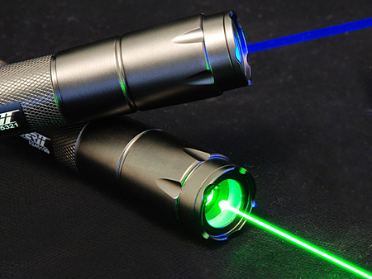
Sources and approaches for this talk? This talk versus other talks today?
Personal reminiscences, anecdotes
Random web sources
Jon’s CV and published papers
“Who’s that writin’, Jon the educator”
“What’s he writin’, Jon the educator”
Other talks today?
My talk?
Focused
Single topic (monochromatic)
Diffuse
Many topics (broadband)
COHERENT
INCOHERENT

Slide 5
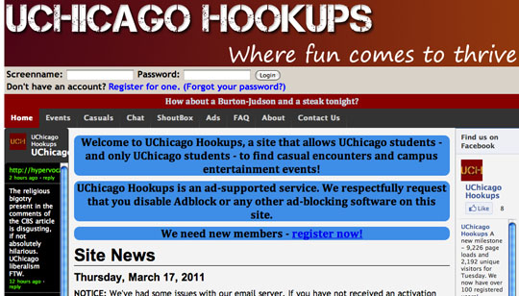
Once again, Chicago leads the way or Maybe Hutchins was right

Slide 6
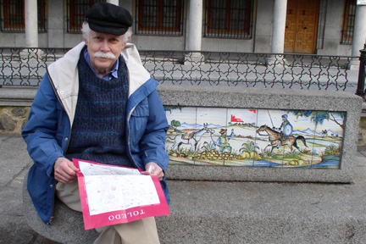
Jon’s ‘hook ups’ and ‘progeny’
Jon has had two long-term relationships
‘Flings’ (Cal Tech, IAS, CERN, FNAL, SLAC, Yukawa, CLNS)
And 22 ‘children’ along the way, with 2 ‘in utero’
5 Minnesota Ph. D.’s
17 Chicago Ph. D’s. M. SC’s and two on the way
Same dad, but two different mothers – lots of half siblings

Slide 7
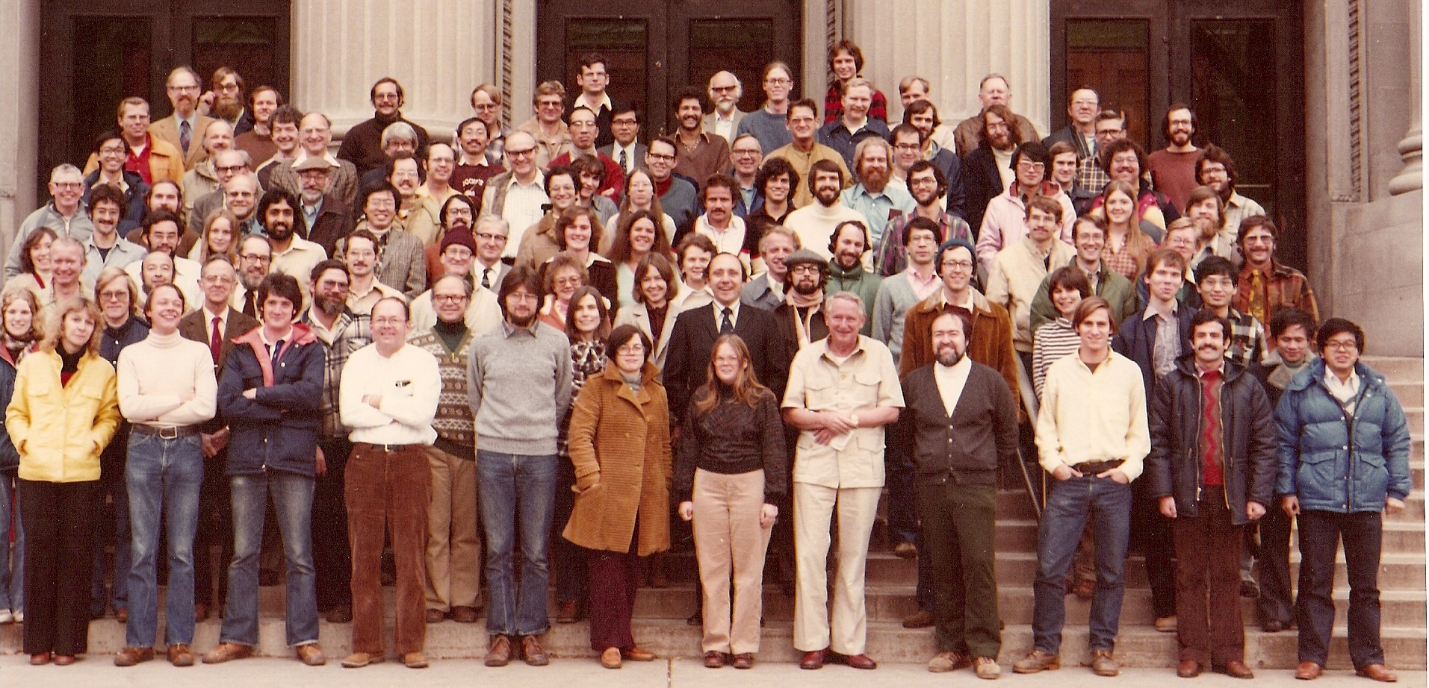
Minnesota days (at least one of them)
UM Physics faculty, staff, and grad students, ca. 1980
Where’s Waldo?
Find Steve Gasiorowicz, Peter Moxhay and Jon Rosner (MIA)

Slide 8
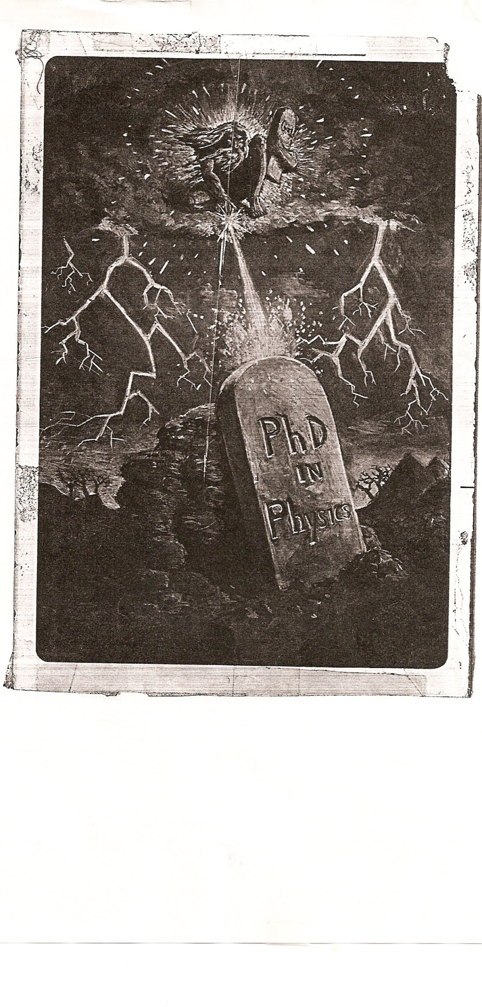
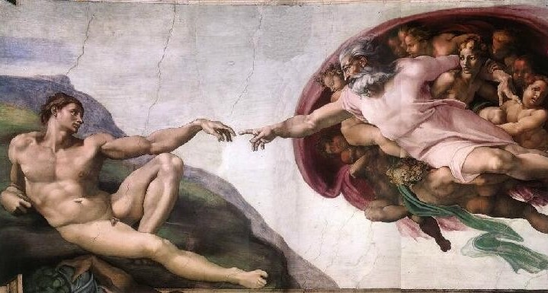
One student’s view of a University of Minnesota Physics Ph. D.
Color chalk painting on blackboard in the UM Physics student lounge, ca. 1980

Slide 9
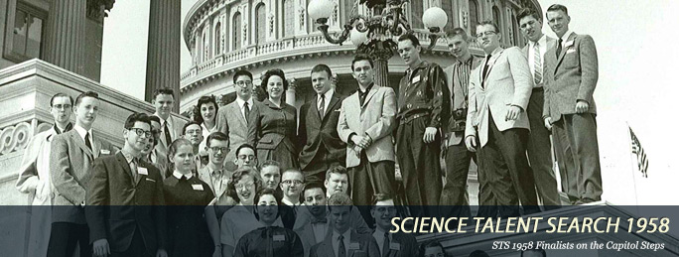
Jon has always had varied interests
“Temperature control in man and machine”
Jonathan Lincoln Rosner (Age 16) , Roosevelt High School , Tuckahoe, New York
1958 Westinghouse Science Talent Search
http://www.flickr.com/photos/societyforscience/sets/72157624917221952/show/
Has lots more photos, including ones of then Vice-President Richard Nixon in attendance

Slide 10
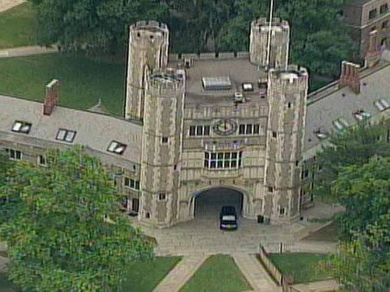
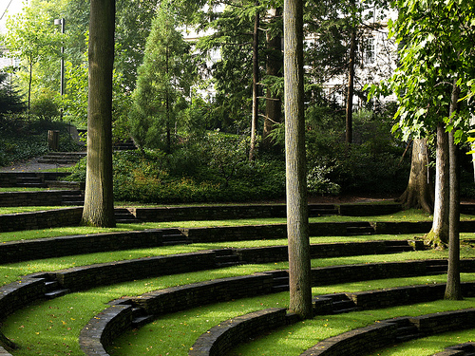
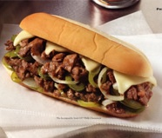
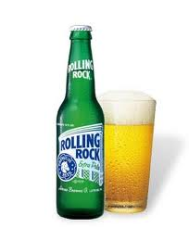
Do we always teach like we learned?
Jon Rosner’s early educational influences

Slide 11
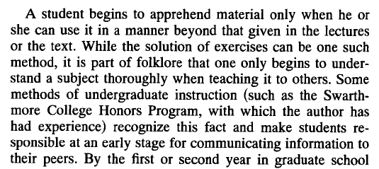
Jon’s own words on teaching
“Experimental projects in graduate theoretical physics courses”, JLR, Am. J. Phys, 1231-1236 (1996)

Slide 12
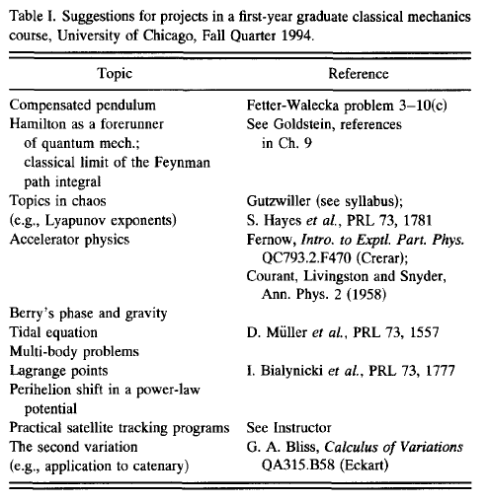
“Experimental projects in graduate theoretical physics courses”, JLR, Am. J. Phys, 1231-1236 (1996)
“The instructor, having spent 10 weeks teaching the students, is ready to learn something from them as well.”
“An early push towards joint efforts thus serves as valuable training.”
Suggested projects

Slide 13
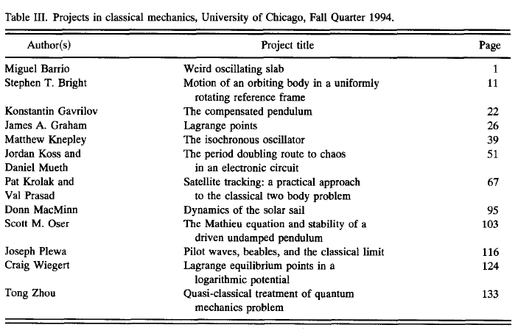
Actual student chosen topics
“…students are generally quite adept at choosing interesting topics on their own…”

Slide 14
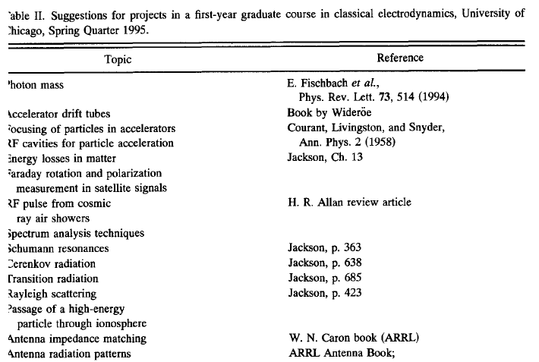
As if Jackson wasn’t hard enough

Slide 15
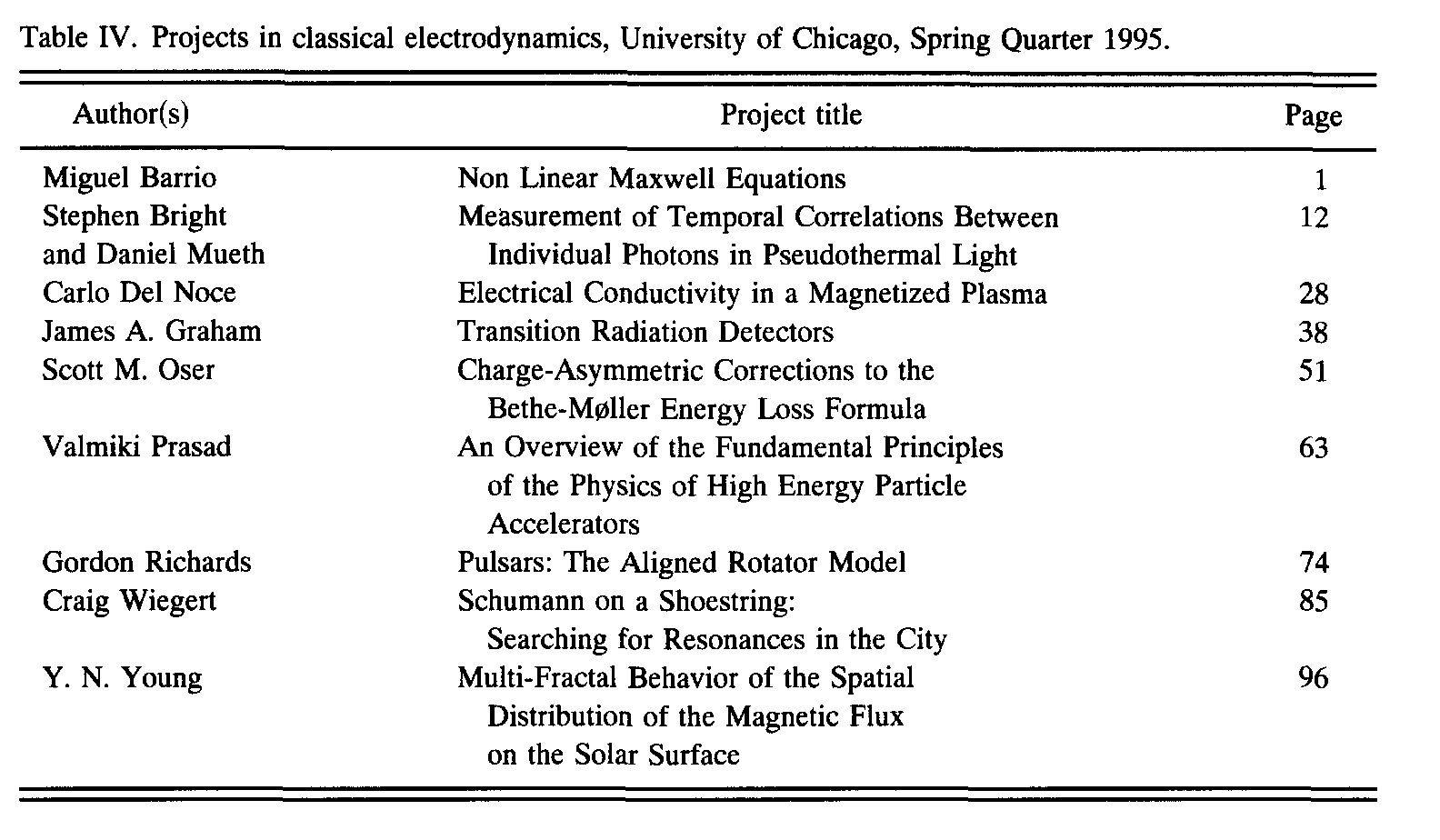
Student chosen topics

Slide 16
The perils of being an experimentalist
One example of such a project comes from an electrodynamics course Rosner taught in spring 1991 in which one student constructed a magnetometer designed to be sensitive enough to detect solar flares by the changes in the earth's magnetic field.
"Initial tests were discouraging," Rosner writes in a paper about his teaching that he plans to submit to the American Journal of Physics. "The instrument appeared to have three steady-state readings, flipping among them apparently at random."
Then the student discovered that the signals came from a nearby elevator. Shortly after the equipment was moved to a better location, it registered a huge deflection, detecting a giant solar flare on June 4, 1991.

Slide 17
Graduate teaching at Chicago
Not surprisingly, he won the 1996 University of Chicago Faculty Award for Excellence in Graduate Teaching
"I learned, understood and enjoyed more physics in [his] classes than in any other graduate course then or since," wrote one former student in support of Rosner's nomination for the graduate teaching award. Another wrote, "In a department known for its strong teaching, Jon stands out as a singularly dedicated and talented individual." Other students cited his meticulous and thorough preparation for class, the quality and clarity of his lectures and the enthusiasm he brings to his subject.
As this quote suggets, he’s not the only good teacher. Other winners include Jeff Harvey, Robert Wald, David Schramm, and Robert Geroch

Slide 18
Personal experiences
Grad particle physics course with Jon at Minnesota – everyone had to give talks
One student did the MIT bag model
Collecting student research/review papers, having them bound and returning to students (like conference proceedings)
“A key feature of these projects is to make the results available to the whole class.”
I shamelessly copied this when I taught jr/sr level courses.
That’s how you judge if pedagogical papers work!

Slide 19
More quotes from Jon
Quotes from this paper which say volumes about Jon’s teaching.
“Final projects also permit the instructor to recall students as individuals rather than as members of a large class.”
Speaks to his obvious mentoring abilities
“Concrete projects can serve as reminders that one is after all dealing with a science whose foundations are experimental.”
Lots of us remember this emphasis on connections to experiment – more later.

Slide 20
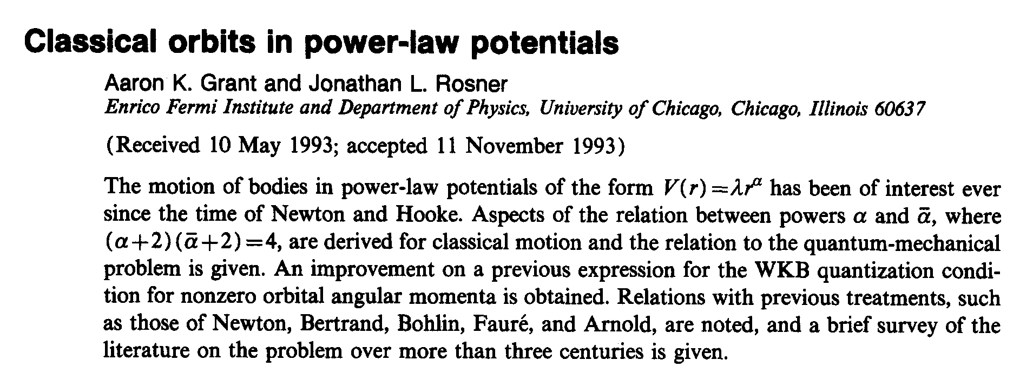
More things I shamelessly used
Nice connections between classical and quantum solutions
I used it as a testbed for a `Mathematica in Physics’ class to do numerical integration of ODE’s

Slide 21
Review articles for AJP
“Resource letter NP-1: New particles”, JLR, Am. J. Phys. 48, 90-103 (1980).
“Hadron spectra and quarks”, S. Gasiorowicz and JLR, Am. J. Phys. 49, 954-984 (1981)
31 pages long! Held the record for longest article in AJP journal history until 2001
Confirmed by Jan Tabochnik, AJP editor
“Resource letter SM-1: The standard model and beyond”, JLR, Am. J. Phys. 71, 302-318 (2002).

Slide 22
Classical analogs of particle effects

Slide 23
Jon Rosner the ‘quantum mechanic’
What I got when Googling ‘rosner’ and ‘quantum’
Jonathan Rosner, Vice President, Corporate Finance at QuantumWave Capital
My interest in quantum mechanics
Steve Gasiorowicz (modern physics)
Ed Tang (jr/sr level quantum mechanics)
Jon Rosner (applications of quantum mechanics to quarkonia – real life applications happening NOW)

Slide 24
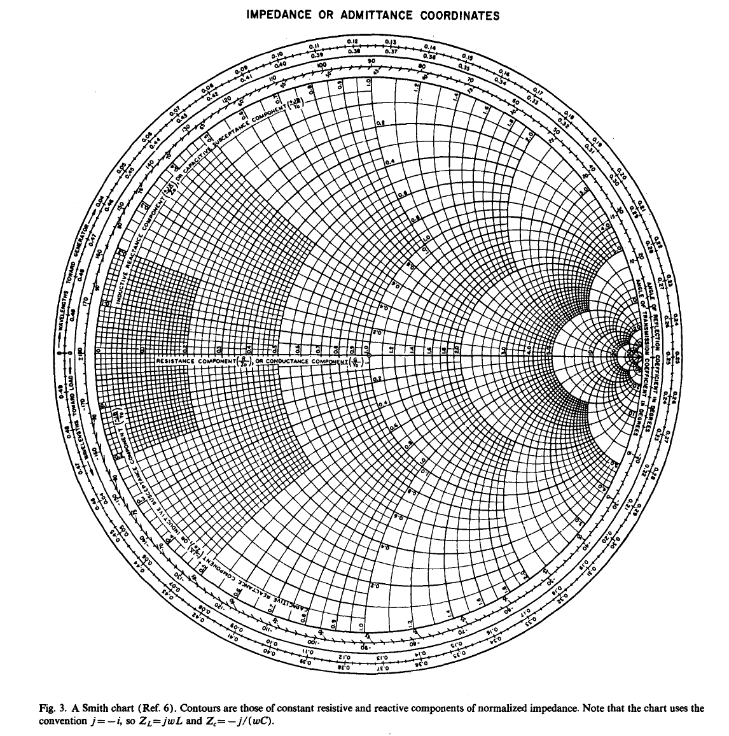
Quantum mechanics and electronics
Nice visualizations using complex numbers (basically an Argand diagram)
We (PSU) have lots of EE majors doing minors with us, using QM as a ‘statistics elective’
Demonstrates his ‘split personality’
Switching between i ↔ –j

Slide 25
Personal memories
“Education is what remains after one has forgotten everything one learned in school”
Noting the date and numbering each new page of ‘theory notes’
I’d only seen experimentalist do this – due diligence and care
Comment as he left the pizza and beer party my soccer team mates and friends threw me the day I passed my Ph. D. exam
“Remember, we still have fish to fry” – just the start of a career
One can always ask for help or advice
“Let’s go ask Ed Witten, he’s just down the hall”
Letters of recommendation, mentoring, career help
I now spend LOTS of my time doing this. Still feel like I’m paying back all that my professors, mentors, etc. have done.

Slide 26
Education in the most general sense
Classroom instruction
Pedagogical innovations
Research mentoring
Career preparation
Jon has done them all well!

Slide 27
Similar comments from another Minnesota student
"Jon has been a great mentor and a good friend. As a graduate student, it was heartwarming to feel welcome to his office as well as his home. An important lesson I learned from Jon was to connect theory with firm experimental evidence. His allowing me the freedom and independence to find and develop my own research interests helped prepare me for and shape my physics career in a very positive way."
C. N. (Terry) Leung – U. Delaware
Terry sends best wishes on Jon’s retirement!

Slide 28
Comments from a Chicago student
The older I get the more I find myself, sometimes consciously and sometimes not, emulating Jon when I advise students. I learned a lot of physics of course -- including especially his attitude as a big fan of experiments -- but some of the most important lessons were a result of his wisdom and warmth. I am surprised to discover that I'm now a bit older than Jon was when I was his student. I can't say I feel I've achieved the level of wisdom he had then, but I do my best to emulate his example. Some random examples: 1. There are phases students go through which are good for them but which they grow out of. But it's up to the student to work through it him/herself. The example is physics problems that excite smart youngsters and can be fun and useful exercises but that ultimately are destined not to go anywhere. It's no use trying to convince the students they're wasting their time; they have to figure that out for themselves. I remember being very excited about one such problem and going to Jon with it. He gently made it clear he wasn't interested in getting involved, while leaving it open for me to pursue if I wanted to. So now when students come to me with these problems, although I'm thinking "Oh no, here we go again" and I'm inclined to be dismissive, I try to respond more like Jon did.

Slide 29
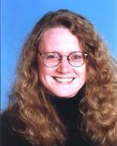
More comments (cont’d)
2. When it came to career advice, Jon was a huge resource for me, because he had some not-so-obvious suggestions that I would never have thought of and which were very helpful. This was especially useful in my case as I tried to coordinate my academic career with my husband's. Jon was especially sensitive to my situation and without his advice and support I would not have been able to make things work out as well as they have. Now I try to pay it forward with students and let them know there may be more options than they think. 3. Jon always encouraged his graduate students to pursue their own interests in their research, without treating us as the hired help or simply means to advance his own research program. When I worked with Jon I was typically one of about four of his Ph.D. students, and we worked on an impressive variety of problems. Now I try to help my own grad students figure out what interests them most, rather than simply assigning specific projects.
Lynne Orr
C. E. Mees Professor of Physics
University of Rochester

Slide 30
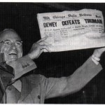
Last subject, congratulations!
Results of 2010 DPF elections
Via Chip Brock - Michigan State University, DPF chair
“I’m pleased to announce the results of the 2010 DPF election as follows:
Jon Rosner of the University of Chicago has been elected Vice-Chair.
Jonathan Feng of University of California, Irvine and Lynne Orr of the University of Rochester have been elected members of the DPF Executive Committee.”
Kudos , ½ sis!

Slide 31
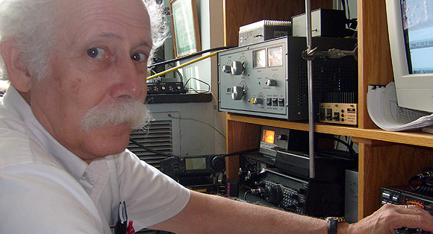
In conclusion, many thanks…
…to Jon L. Rosner (the Educator)…for his heroic efforts in all of these areas…
…and since all superheroes have an alter ego…
…best wishes to WO9S as well!

